Slide 1
The Value of Certification
Recent Research the Makes the Case
Notes:
Hello everyone thank you for some time on the agenda today to talk to you about some highlights from the value of certification research project that ONCC completed in 2022-2023.

Slide 2
ONCC® believes certification makes good oncology nurses even better.
ONCC provides the premier nationally accredited certifications for nurses in oncology and related specialties.
Founded in 1984 as a non-profit organization, ONCC administered the first Oncology Certified Nurse (OCN®) examination in 1986.
Today, ONCC offers eight credential programs and has more than 41,000 currently certified nurses.
All ONCC certification examinations are accredited by the National Commission for Certifying Agencies. The NCCA independently determines if credentialing organizations meet established standards.

Slide 3
What we know from previous surveys
By ABNS and I.C.E.
Notes:
To kick things off it might be helpful to share a few findings from two other studies that were conducted in the last three years one by ABNS (the American Board of Nursing Specialties) which is a consortium of certifying boards for specialty nurses that ONCC is a part of and the other by the Institute for Credentialing Excellence (or I.C.E.) which is an organization obviously focused on the credentialing space. ONCC was a part of the ABNS study, and our nurses responded to the survey that was done for that project. ONCC and oncology nurses were not a part of the I.C.E. study.

Slide 4
The Value of Certification
Specialized knowledge
More in line with standards than non-certified nurses
Strong sense of pride and accomplishment
More confident in ability
Sense of personal satisfaction
Professional growth
Shows commitment to profession
Notes:
ABNS survey
Here you see some of the top responses from the ABNS study, and we’ll see these repeated in the findings from the other studies, as well.
Across the survey, oncology nurses rated both intrinsic and extrinsic value propositions higher compared to responses from other organizations.

Slide 5
The Value of Certification
Increased their professional confidence (83.9%)
Enhanced their confidence in professional interactions (83.7%)
Kept them more strongly connected to the profession (82.6%)
Credential holders make better decisions on the job (56.5%)
47.7% responded that credential holders had greater job satisfaction
Notes:
Here are some of the top responses from the I.C.E. study. You can see some repetition from the ABNS findings.

Slide 6
The 2022-2023 ONCC
Value of Certification Survey
Notes:
Now let’s take a look at the ONCC survey.

Slide 7
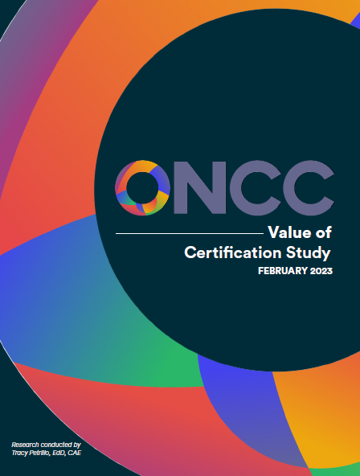
The Study
Part of 2020-2023 Strategic Plan
Used Perceived Value of Certification Tool
instrument like other studies
ONCC certified & non-certified nurses
Provided updated insights
Staff incorporating into messaging
Full report is available at
https://www.oncc.org/benefits-certification.
Notes:
Completing this study was part of ONCC’s 2020-2023 Strategic Plan. ONCC partnered with consultant, Dr. Tracy Petrillo, who is a leader in the association management and credentialing space and conducted her dissertation on a similar study with Certified Association Executives. Like her doctoral study, and the others I mentioned earlier, ONCC used the Perceived Value of Certification Tool—which was developed and validated by CCI – the Perioperative Nurses Certification Board. We surveyed both oncology nurses certified by ONCC and those that were not.

Slide 8
Overview
3% total response rate (N=1,299 of 45,591 contacts)
Respondents:
  78% held the OCN®
  10% (N=134) never held ONCC certification
  78% of respondents were ONS members and 6% were APHON
58% indicated their employer financially support certification
ONS members expressed stronger agreement
Notes:
Here are some specifics regarding the respondents to kick things off. The survey response rate was a bit low, but the information is still valuable! You can see that many respondents were certified by ONCC and only 134 never held an ONCC certification. When you compare responses to the ONCC survey with those of the ABNS and I.C.E. studies, the study ratings are similar (higher in some cases). That reassures that results are trustworthy, in general, despite our lower response rate. The high % of ONS members—meaning they are highly-engaged—provides insight into our slightly higher % ratings versus the larger ABNS and I.C.E. studies, as well—since highly engaged individuals typically are more positive.
Two interesting takeaways right of the bat were that 58% indicated their employer financially supports certification—very good to see! And that those who indicated ONS membership were, indeed, more positive…expressing stronger agreement to most of the top value statements than non-ONS members.

Slide 9
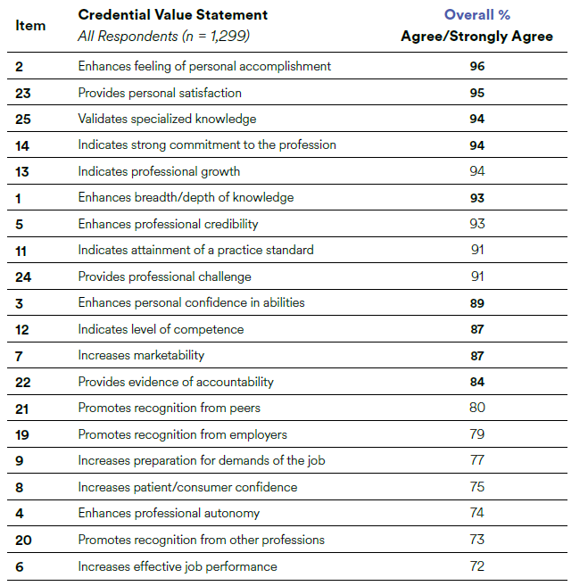
Notes:
Here are the top ¾ of the value statements with the combined “top two boxes” (or Agree plus Strongly Agree) ratings. I’ll break this down a bit next, but did want to note that after the last statement listed here, the %s drop to the 40s…so a natural break in the level of agreement with the statements. You can read the rest of the statements in the full report that is available on the ONCC website.

Slide 10
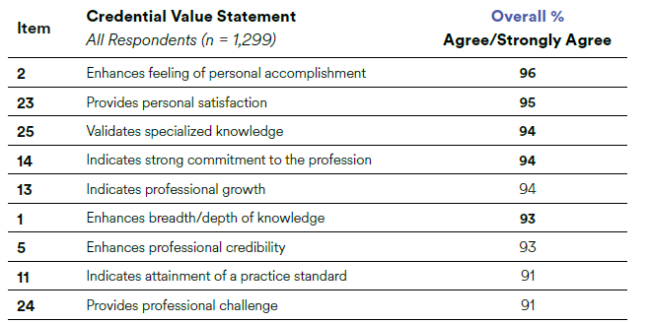
Notes:
Looking at the top 9 statements—the ones earning a rating in the 90s—you see many of the value propositions I shared previously from the ABNS and I.C.E. studies. There were not many surprises in the ONCC study findings, but it does offer current validation of the value of certification expressed by nurses for many years.

Slide 11
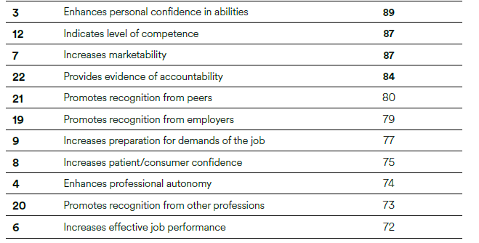
Notes:
Here are the next 11 statements in ranked order. Again, after #6, the ratings drop to the 40s.

Slide 12
Notes:
In this set of value statements, we see more items that are extrinsically focused versus intrinsically. That is, value based on how others view or consider the certificant versus value derived strictly from how it makes them feel or relates to them, personally.

Slide 13
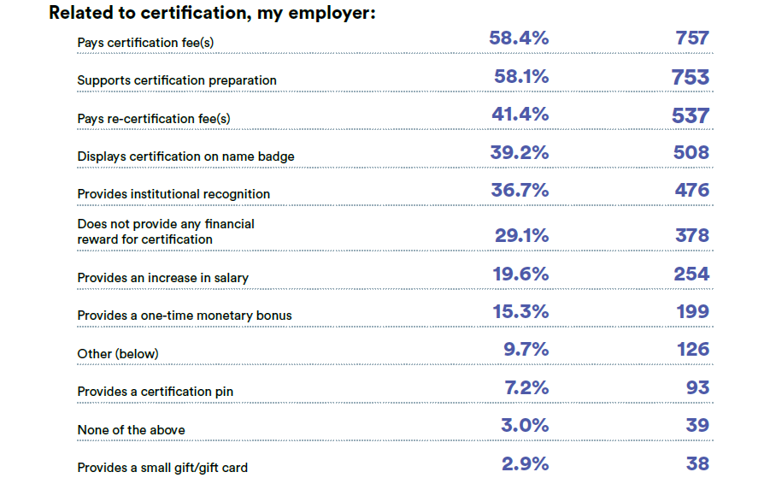
Notes:
Another interesting section of the report breaks out responses related to employer rewards and recognition. This is good information for sharing with those working to create or nurture a culture of certification in your institution. Employers and nurses in an organization generally either support certification or do not. It’s often heavily influenced by the attitude of those “at the top”. But one champion for certification can change a culture with good information, resources, and persistence. Knowing what other employers offer can be an important tool in changing the mindset.

Slide 14
Notes:
One surprising outcome for in this section is the % of employers that pay for re-certification. It is often thought that employers pay for certification but not renewal. Seeing 41% pay for renewal (at least for this study’s respondents) is exciting!

Slide 15
Significant takeaways from cross-tabs
Salary Increase Provided – “Anchor effect” for those whose employer does not provide
Current v Never Certified Respondents – Certified nurses rated “time-consuming” and “costly” lower than others (lesser concerns)
Young Demographic – Rated “certification promotes recognition from employers” higher than others
Workplace Setting – No significant differences
Inpatient Setting v Ambulatory – Those working inpatient indicated lower support in recognition from peers, employers, and other professions as a value of being certified.
Notes:
To wrap things up for this overview, here are takeaways from some of the cross-tabs included in the report.

Slide 16
The Value of Certification
A 2022-2023 Research Initiative
https://www.oncc.org/benefits-certification
Notes:
That’s a high-level review of the study. The full report is available on the ONCC website.

